Slide 1
ALL ME
By Bri Dixon
BC3

Slide 2
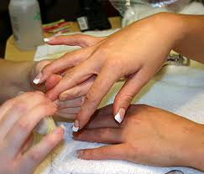
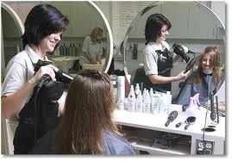
What I Want To Do
I want to go to school for cosmetology. A cosmetologist is someone who does hair for weddings, prom, and sometimes just regular hair cuts and dyeing. Cosmetology also includes nails and sometimes doing ones makeup.

Slide 3
Who?
My name is Brittany Dixon (Bri for short). I am very diligent when I’m doing what I need to do, I listen well to my superiors. I’m fun, enjoy doing hands on work/activities, and I’m full of energy. I enjoy spending lots of time with friends and family.
I want to be able to attend Empire Beauty School and become a cosmetologist

Slide 4
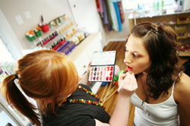
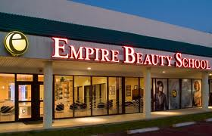
Goal #1
I want to graduate from Dansville High School and attend Empire Beauty Schools in Grand Rapids, Michigan.

Slide 5
How Do I Get There?
In order to become a cosmetologist I need to get a high school diploma and attend some type of cosmetology college, cosmetology school, or beauty school (I plan on attending Empire)
Ill need to have passion and persistence and be very committed
Ill need to have experience and pass classes in chemistry, and learn sterilization and sanitation
Tuition cost somewhere between $6,500 and $10,000 so ill need to save up for that and/or get tuition help if I qualify

Slide 6
Empire Beauty School
Empire Offers The Following
Hands On
Hands on Experience
Flexible full-time and part-time programs
Financial aid for those who qualify
More than 100 locations in 21 states
Complete beauty training in hair, skin and nails
Learn business building methods and customer service skills
Trained professional in a year
Use creativity to help people look their best

Slide 7
Empire Beauty School
Educator Training
Empires Cosmetology Program (I plan to take)
Educational techniques using there exclusive curriculum
Instructional techniques to help the student guide a classroom
Training to help the student develop lesson plans and team-building methods with your own student
Cutting and styling techniques
Color and texture
Hair cleansing
Basic skin care
Makeup and nail tech.
Business development
Retail

Slide 8
My Plan
I plan to use this education I get at empire beauty schools to hopefully pursue a career as a cosmetologist because I really enjoy doing hair, makeup and nails. I like being able to make other people feel beautiful and refreshed

Slide 9
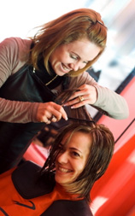
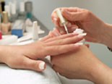
Goal #2
I want to be able to finish beauty school and graduate and be able to get a job in this career zone. I want to be able to do what I really like

Slide 10
Experience
I’m not going to lie, I have no school related or work experience in cosmetology. But I have grown up around it. My grandmother did hair and nails for a living, she used to always show me and teach me how to do all the stuff because I was so interested. As I got older, I started cutting and doing my own hair, then later my parents let me do my little sisters and brothers hair.

Slide 11
Experience cont.
Another way I've gained experience is through my friends. I cut and style my own hair, including dyeing it. My friends noticed how well I do my own hair and have asked me to do theirs as well. So not only do I do my family's hair, but also my friends. They trust me enough to dye it and cut it for them as well.

Slide 12
In The End
In the end I hope to be able to help people look there best and feel there best while making myself feel accomplished.

